Slide 1
B0. Introduction
React Course : Basic part

Slide 2
What is all about?
Web application development and unified core for mobile
Typescript / ES6
React
React ecosystem : state management, UI

Slide 3
Course team
Artem Krasnyi
Yevhenii Osadchyi
Anton Vitiaz
Dmytro Pisotskyi
Maksym Pushchynskyi

Slide 4
Course structure
Basic & Advanced part
3 days in class
Homework
Self education
Google practice
Talk to colleagues
Talk to mentors
Practice, practice and practice (90% of success)

Slide 5
Day schedule
Coffee start, welcome, remember everything: 9:00 – 9:15
Go-go-go: 9:15 - 10:45
Brake 1 : 10:45 – 11:00
Ok, lunch soon: 11:00 – 12:45
TGIL : 12:45 – 13:30
Good lunch, have to sleep: 13:30 – 15:00
Brake 2 : 15:00 – 15:15
Wow, we have to do a lot: 15:15 – 16:45
Brake 3 : 16:45 – 17:00
Q&A

Slide 6
Basic part
B0 - Introduction to basic course
B1 - Functional programming concepts
B2 - ES6 concepts
B3 - Typescript basic concepts
B4 - JSX
B5 - Redux
B6 - Component Lifecycle events (+ Pure Component, context, latest React features)
B7 - Types of components (functional, classes, containers)
B8 - Component props and state management (React)
B9 - Work with React forms
B10 - Webpack, babel, yarn(npm), project config, and structure
B11 - Styling approach (CSS, Sass)
B12 - UI frameworks overviews
B13 - Logging (Sentry)
B14 - Debugging React (needs config before presenting)
B15 - Unit testing, snapshot testing, testing UI components

Slide 7
Advanced part
A0 Introduction to adv course
A1 ES6 Advanced - Generators, async/await in details
A2 Typescript impact on React - generics components, Props interfaces
A3 Advanced React Reduх – middleware & custom middleware
A4 Advanced React components, context
A5 Redux-Saga / Redux-thunk
A6 High Order Components in React with best practices
A7 Routing, connected-router
A8 Socket.io with Sagas
A9 Caching possibilities (memoization, etc.)
A10 Templates, best practices, authorization, partial data loading, security
A11 Integrational testing
A12 Lazy loading, chunks
A13 Patterns in React (bad and good practices, patterns misuse)
A14 I18n, localization
A15 Advanced project configuration and tools

Slide 8
Homework
React & Typescript application
Based on course materials

Slide 9
Environment
Visual Studio Code
Packages tools - npm / yarn
Browser

Slide 10
Course materials
Presentation
Referenced materials
Code repository
Recommended Books

Slide 11
Organization things around
Share contact
Common repo for all students
Common e-mail for help request messages
Common notebook for sharing Knowledge base

Slide 12

ASAP Version : all in 10 minutes

Slide 13
Typescript
Mix JS with C# ☺
Google helps ☺

Slide 14
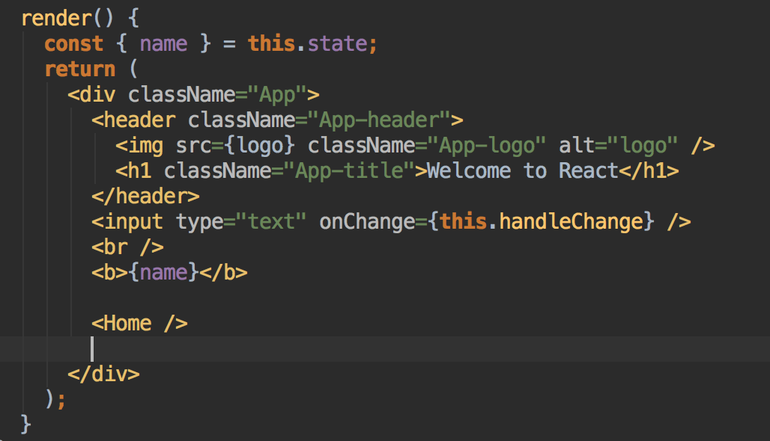
UI via JSX

Slide 15
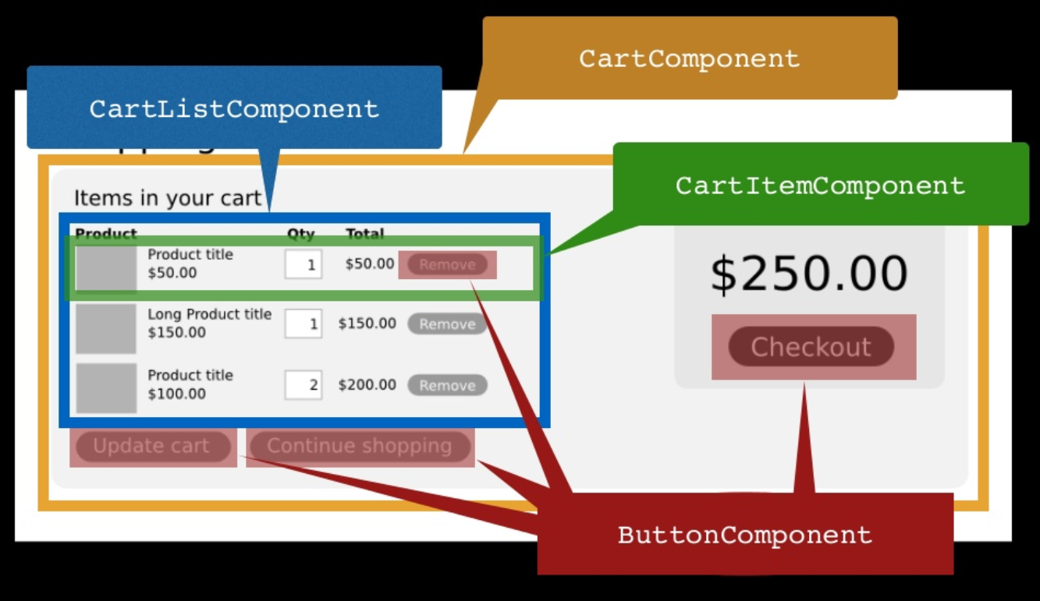
Everything component

Slide 16
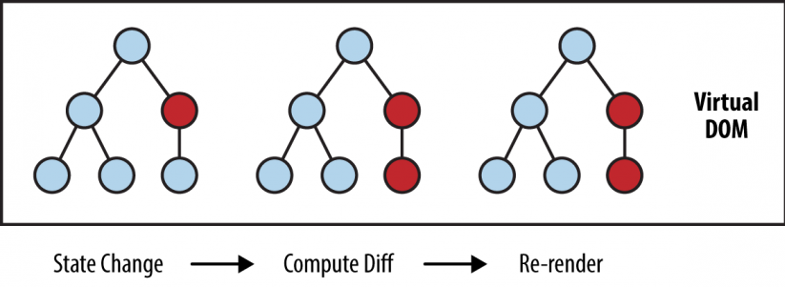
How its works

Slide 17
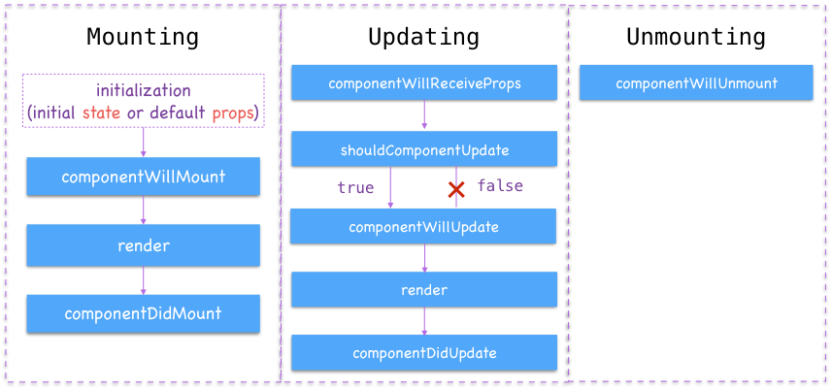
Component life cycle

Slide 18
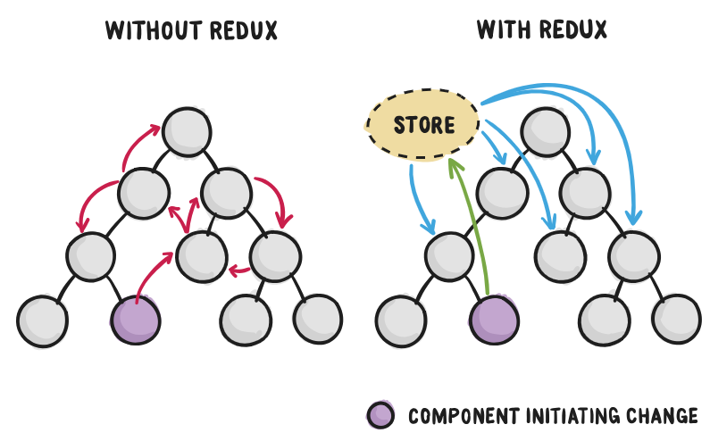
Redux come to play

Slide 19
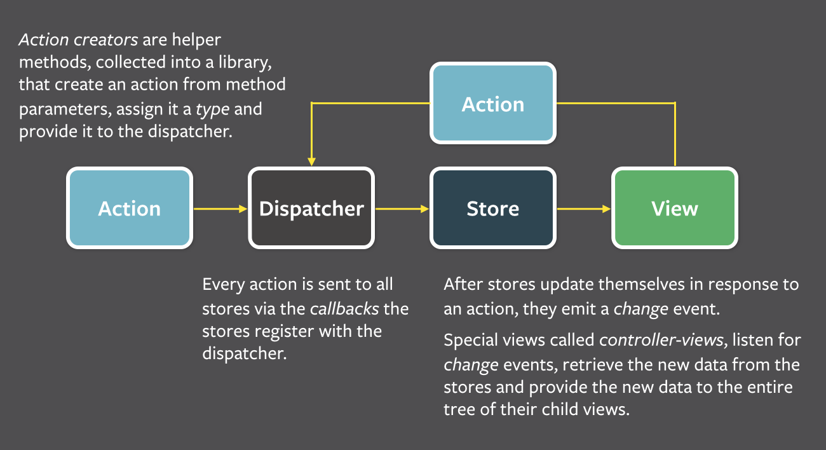
Pattern shift

Slide 20
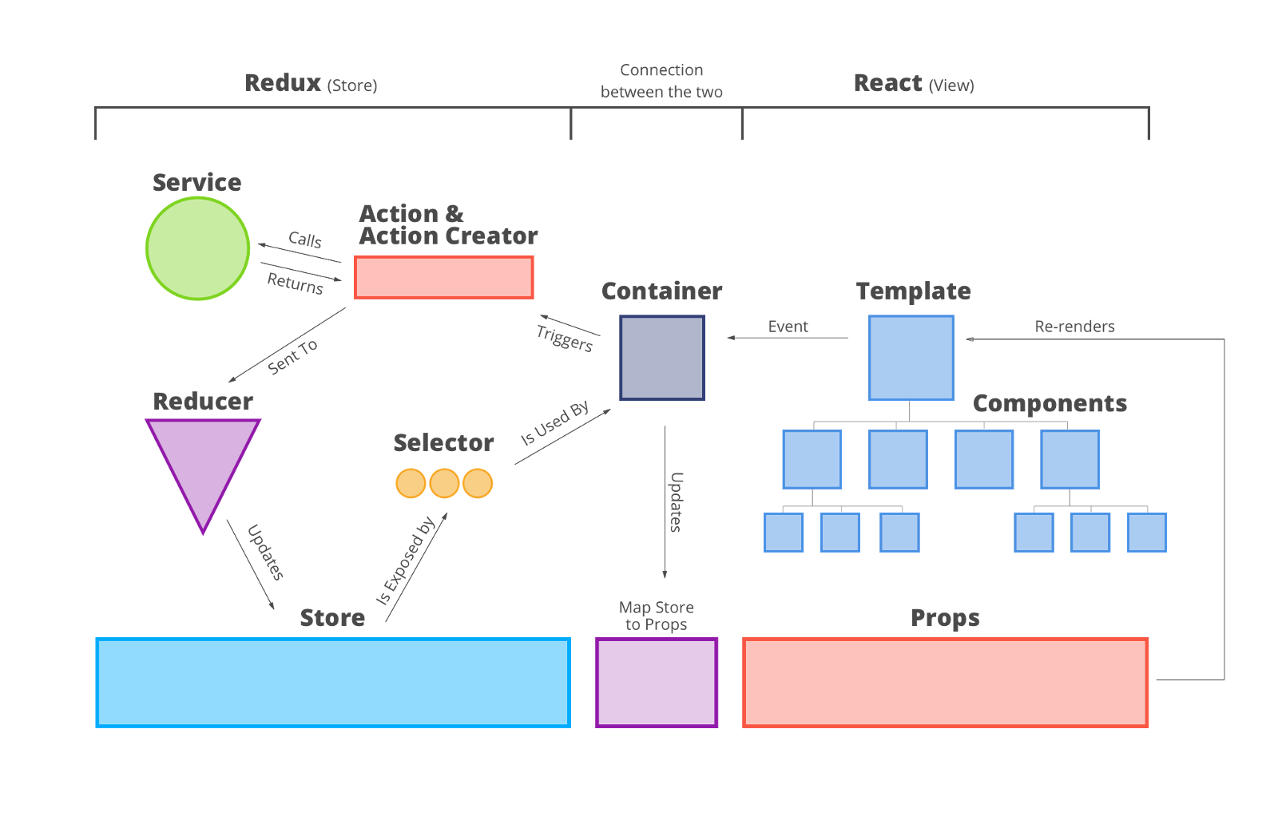
Architecture overview

Slide 21
Thinking about it …
To solve one BIG problem: building large applications with data that changes over time.

Slide 22
Thinking about it …
Simple.
Simply express how your app should look at any given point in time, and React will automatically manage all UI updates when your underlying data changes.

Slide 23
Thinking about it …
Composable. React is all about building reusable components.
In fact, with React the only thing you do is build components. Since they're so encapsulated, components make code reuse, testing, and separation of concerns easy.

Slide 24
Thinking about it …
The thing that I have liked most about React has been the loosely coupled architecture, the thing that has been the hardest is the loosely coupled architecture.

Slide 25

ASAP finished
And you are ready to go

Slide 26
Thanks for completing B0 ☺

